Slide 1

REAPS
Harbord Public School
&
North Sydney Demonstration School
October 2022

Slide 2

Problem solving, what we noticed
They developed a deeper understanding of the problem through ;
conducting a deep dive into one stakeholder's perspective of the problem, and
Being exposed to multiple perspectives of the same problem

Slide 3
A deeper understanding of the problem
STAKEHOLDER | PROBLEM STATEMENT | CRITERIA FOR SOLUTION
FAMILIES | we care about protecting the future for the children | Is it doable Does it positively impact the environment Will it lead to a better future
KIMBRIKI TIP | We are responsible for managing waste in an environmentally friendly way | Is it doable Does it positively impact the environment Does it help with community waste
FIRST NATIONS PEOPLE | We have a special connection to the land | Is it doable Does it positively impact the environment Does it strengthen our connection to country
FRIENDS OF FRESHWATER | It is our responsibility to keep our local environment free from pollution | Is it doable Does it positively impact the environment Does it protect the local environment
WOOLWORTHS | We need to keep our food fresh, but our customers are concerned about the environment | Is it doable Does it positively impact the environment Will it meet our needs and keep customers happy
The world is dependent on plastic because it is suitable for many purposes, however, this it's impacting on our environment,
and this concerns our stakeholder because......

Slide 4
Students generated more ideas and better ideas when using the five simple rules
*No evaluation(No judging each other’s ideas good or bad)
*No elaboration(This is not the time to expand upon the idea)
*Accept all wild and out-of-the-box ideas
*Go for quantity, not quality
*Hitchhike ideas are acceptable and encouraged

Slide 5

Creativity, what we noticed
Processes for generating ideas improved
" I think ..... every idea is … well you don’t want to judge it, it's just imaginable. It's not real, it's just an idea that someone has given you to put down on the paper …" Year 4 student

Slide 6
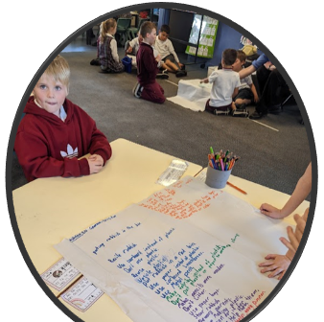
Students had more opportunities to be creative
Generating possible solutions
Generating possible ways to represent their solution E.g., a model, a play, a flow chart
Generating possible ways to communicate their solution E.g., a video, a power point, a speech, a book, a play

Slide 7
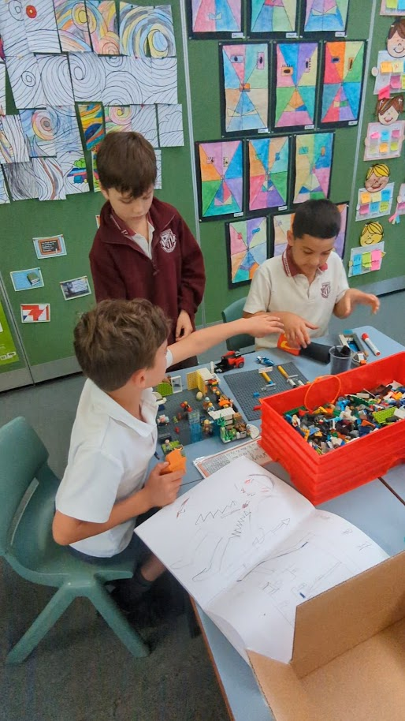
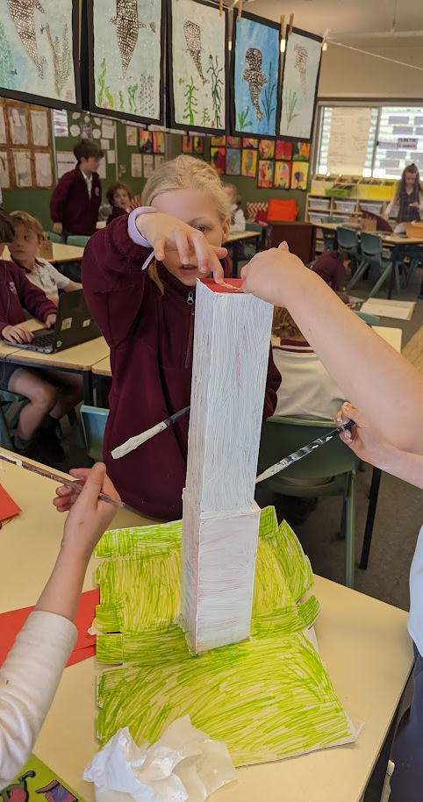
Students had more opportunities to think critically and work collaboratively
Choosing a solution using a criteria
Choosing how they will represent and communicate the solution using a criteria
Implementation of the solution and the communication plan
Evaluating the solution and their teamwork

Slide 8
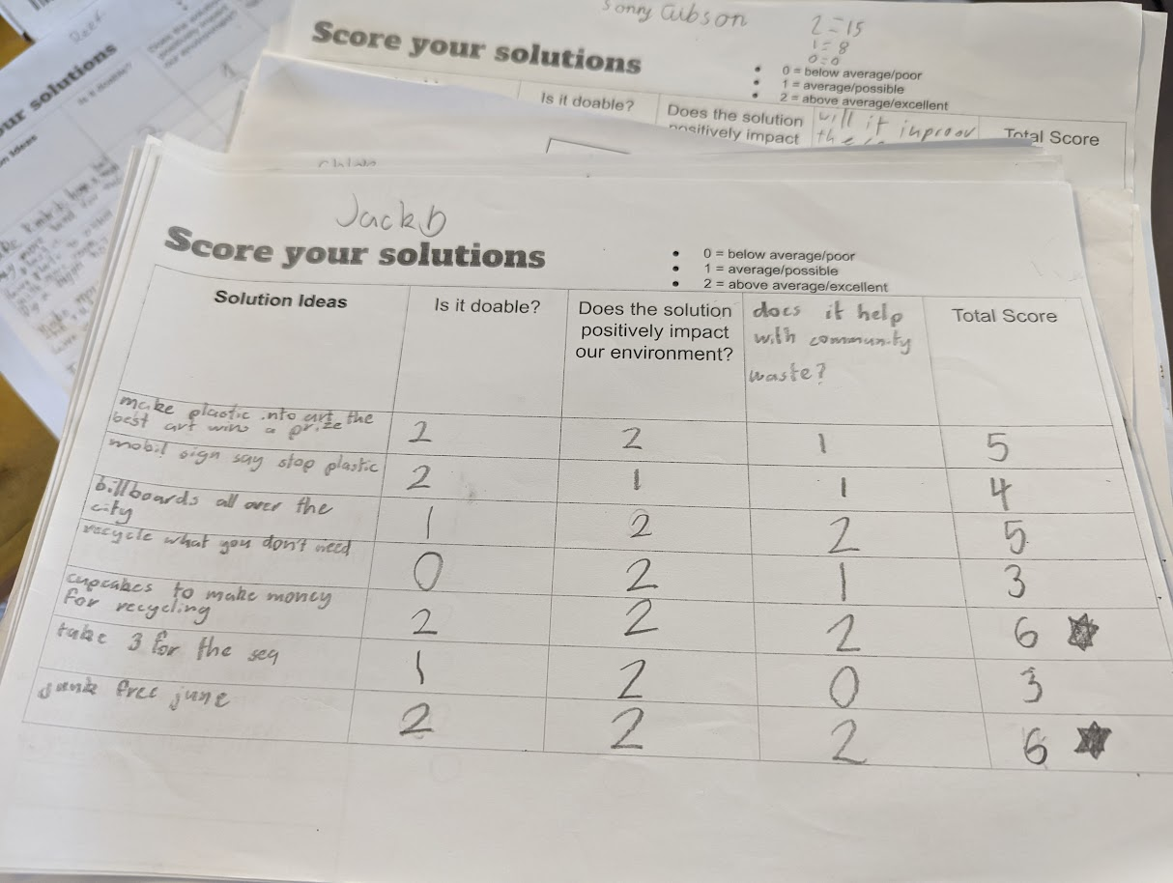
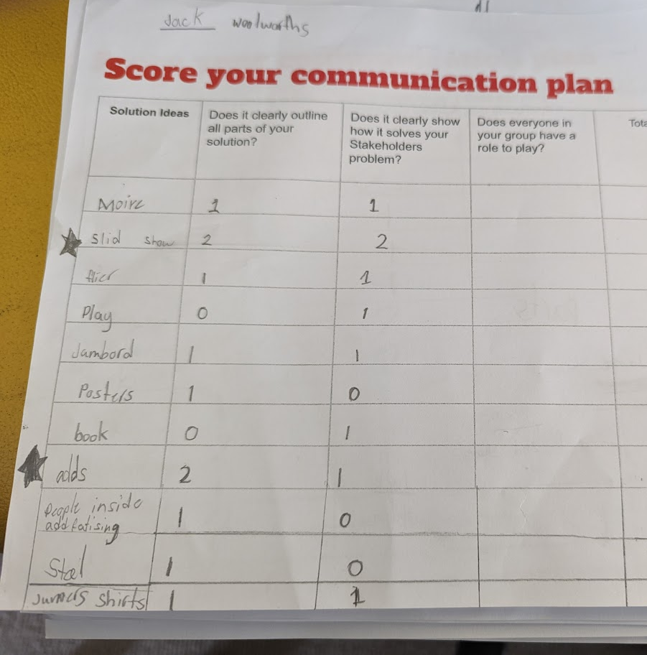
Score your communication plan
Score your solutions
Notes:
Mention here how they would complete the scoring rubric individually and then be prepared to defend their scores.
Mention the use of roles to support cooperation and voice

Slide 9

Supporting teachers prior to implementation
Collaborative planning
Conceptual programming
Experiential professional learning
Differentiated professional learning for new teachers

Slide 10
Supporting teachers during planning and implementation
Acknowledge the cognitive load of early implementation and choose content and stakeholders accordingly
Encourage team teaching and cooperative teaching, where possible

Slide 11
Supporting teachers during planning and implementation
Use REAPS to support deep learning not as your culminating assessment task
Know your parent population, what stakeholder experts are in your parent body. Seek their assistance in building student understanding of stakeholder perspective

Slide 12
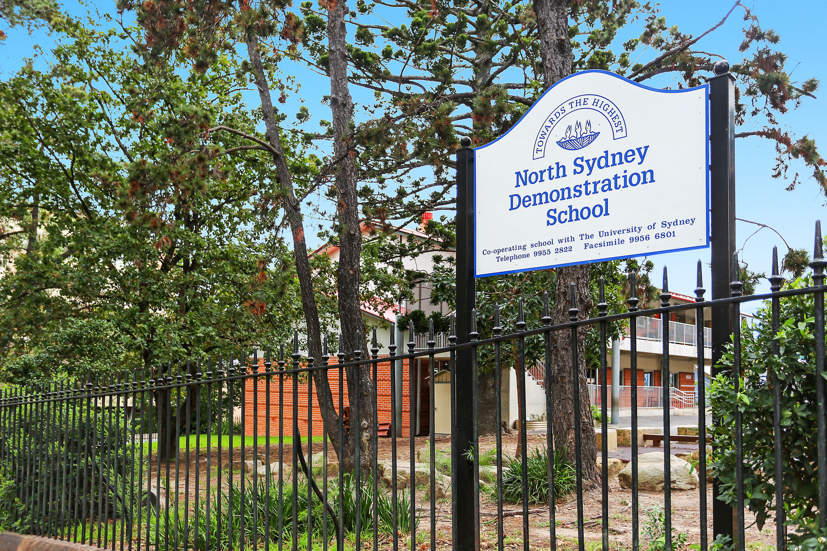
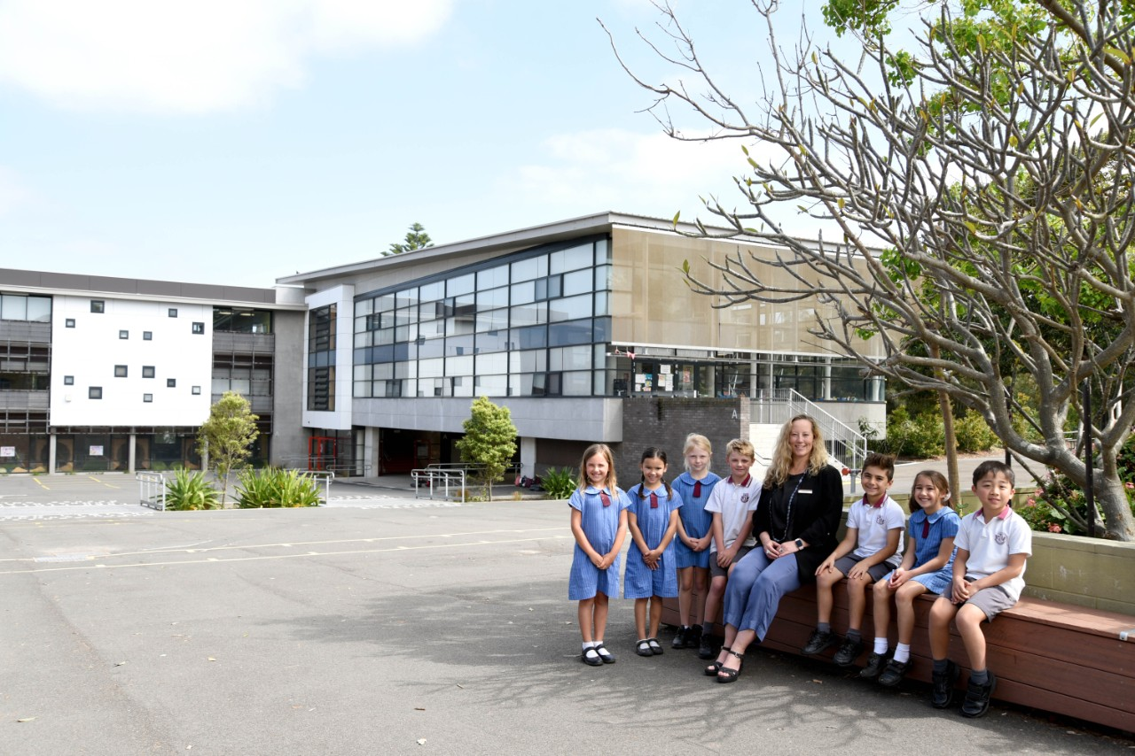
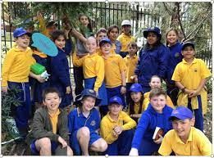
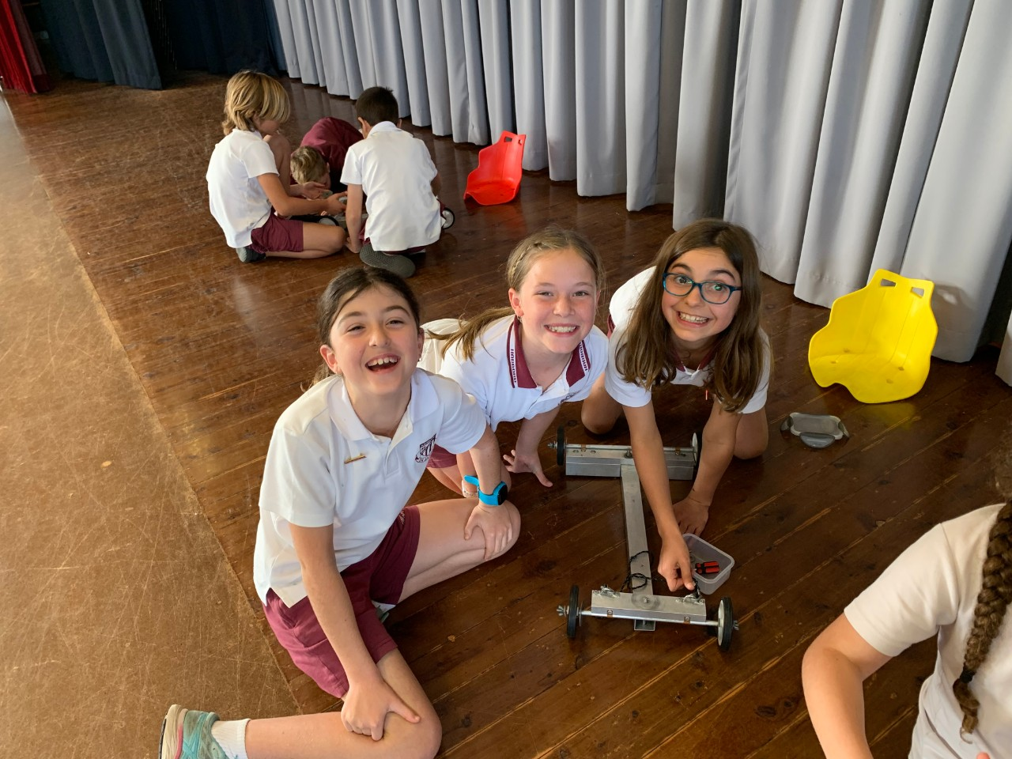
About us
North Sydney Demonstration School
Harbord Public School
Large metropolitan primary school
High socio-economic population
Transient population
49% diverse background
Large metropolitan primary school​
High socio-economic population
REAPS 2013- 2019
REAPS 2022
Susan.tickle@det.nsw.edu.au Harbord PS
Myra.janes@det.nsw.edu.au North Sydney Demonstration School

Slide 13
Why REAPS at Harbord Public School ?
•Harbord is a school of over 1000 students with wide ranging student abilities K – 6
•REAPS is a great tool to identify gifts and talents in students not previously identified (twice – exceptional, in particular).
•REAPS provides a 'low floor / high ceiling' which other teaching and learning programs and assessments don't provide
•NSW Department of Education priorities are around building the general capabilities of students in the 5 Cs, and this is also an area at HPS that we felt we needed to explicitly teach and focus on, alongside a crowded curriculum.
•With high priority given to literacy and numeracy skills and acquisition we need to advocate for these 'soft skills' and executive functions, such as problem solving for C21st learning.
•Limited resources in schools and the need for inclusivity makes REAPS a perfect vehicle for 'talent development for the many"

Slide 14
Why REAPS at North Sydney Demonstration School?
To protect the time and space required for critical and creative thinking, collaboration, cooperation and problem solving.
To nurture, identify and develop the gifts and talents of our students
To keep all students engaged in their learning
Notes:
Public education values many things, but measures only one. That narrow lens that we are measured through puts pressure on every school ,every principal and every teacher to do better in that one area and this focus if we are not careful comes at the expense of educational programs that develop and nurture our students critical , creative and problem solving abilities..

